Slide 1
Deep learning Basics-II
Shreya Khare
IBM – Research

Slide 2
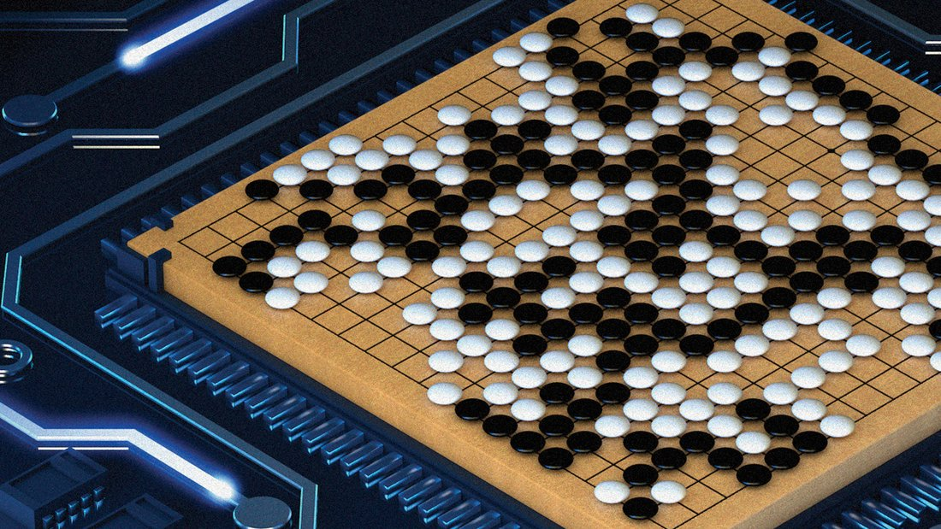
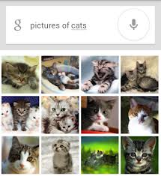
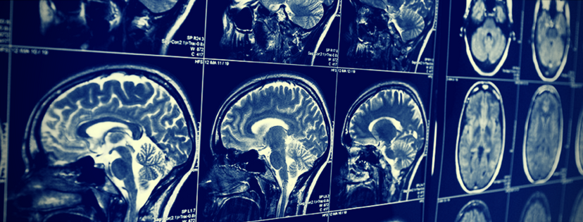
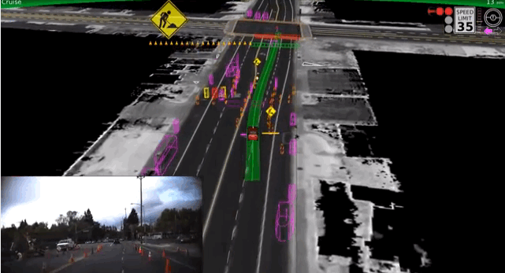
Convolution Neural Networks (CNN)
Brain child of Yann Lecun
Most popular deep learning architecture
CNN is now the go-to model on every image related problem.
Applications:
Face Recognition
Object recognition
etc

Slide 3
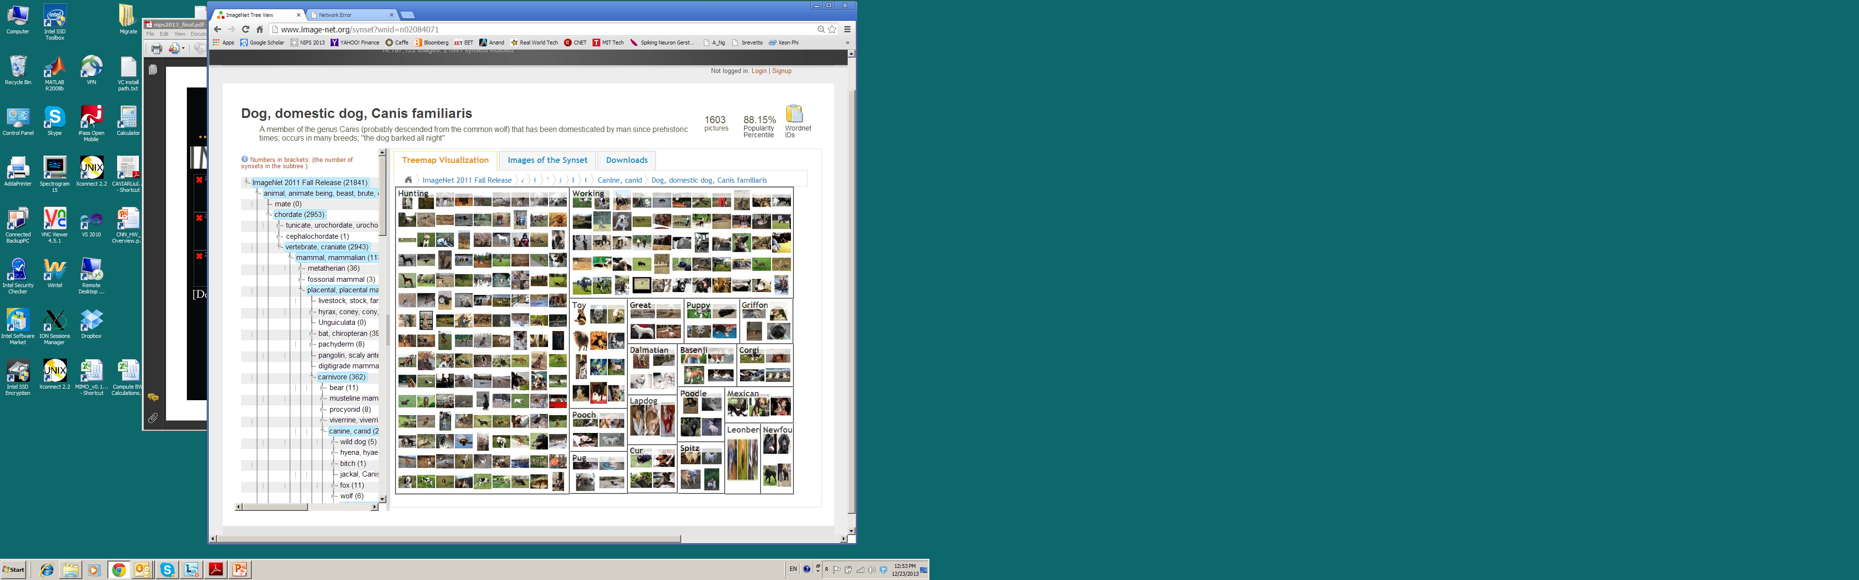
CNN Success Story machine beats human
Image-net data base:
14 million labeled images,
20K categories

Slide 4
CNN Components
Convolution Layer
Pooling
Relu
Fully connected

Slide 5
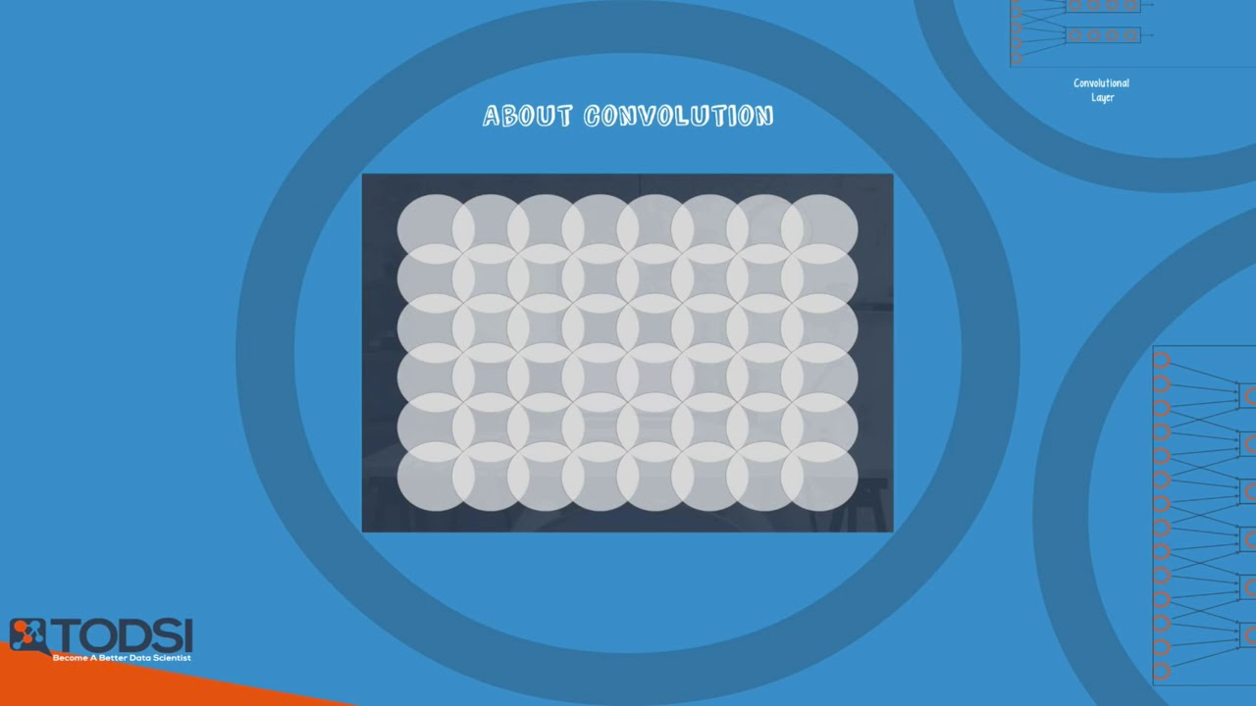
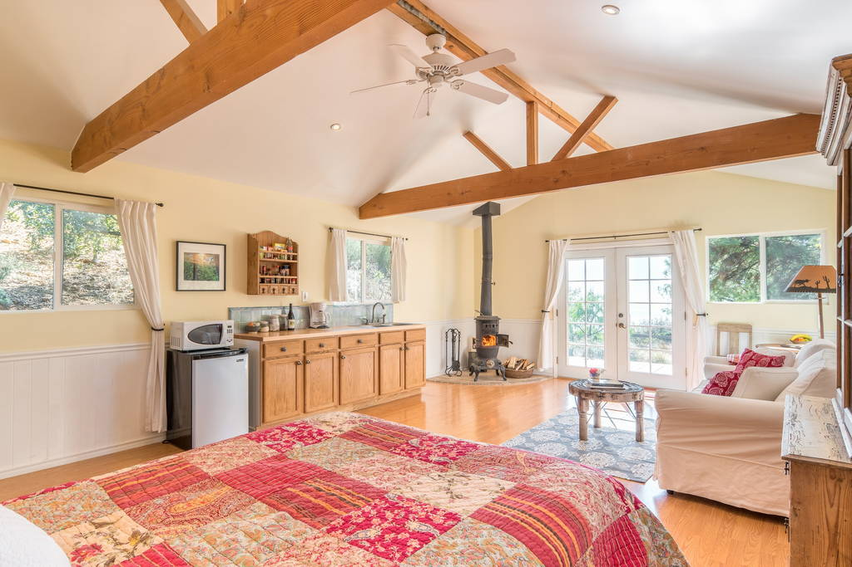
Convolution Layer
Main building block

Slide 6
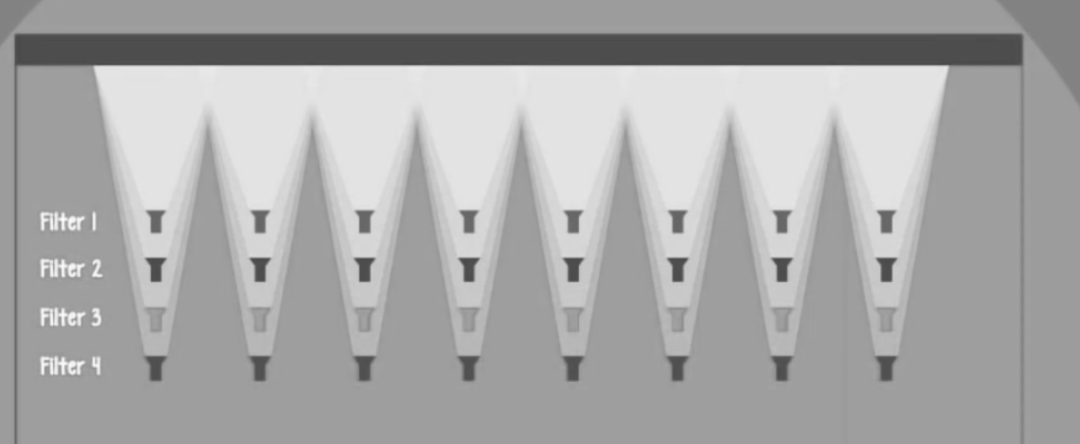
Convolution Layer

Slide 7
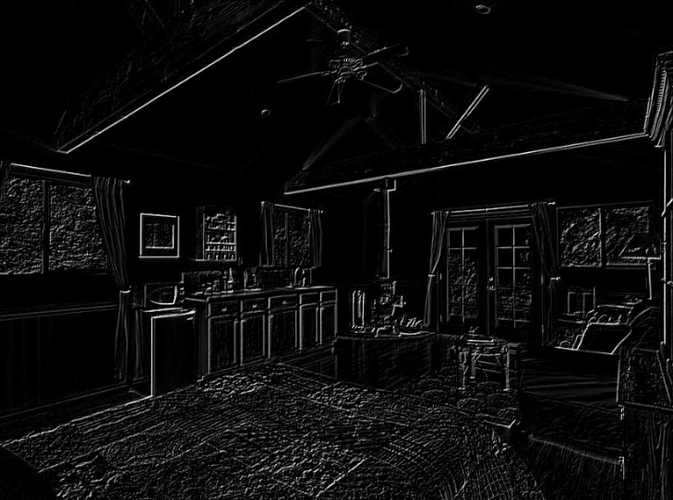
Convoluted Image

Slide 8
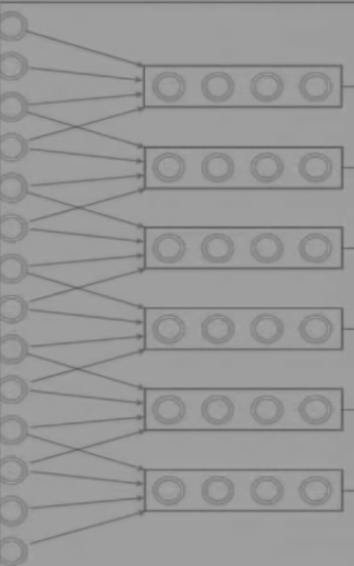
Convolution Layer
CNN: Neuron is only connected to the input neurons it shines upon
MLP: Every neuron in a layer is connected to neuron in the adjacent layer.
Neuron in a given a filter, share same weight and bias, hence they look for same pattern in different section of the image

Slide 9
Convolution Layer
MLP:
Every neuron in a layer is connected to neuron in the adjacent layer.
CNN:
Neuron is only connected to the input neurons it shines upon
Neuron in a given a filter, share same weight and bias, they look for same pattern in different section of the image

Slide 10
Other Layers
Relu
Compress the outputs between the range (0, 1)
Pooling Layer
Focusses on only relevant patterns discovered.
Pass only the max value in the filter to the next layer.
Fully Connected Layer
Fully Connected layer is to use these patterns for classifying the input image into various classes based on the training dataset.

Slide 11
Summary

Slide 12
CNN – State-of-the-art
VGG Net
Block-1
Block-2
Block-3
Block-4
Block-5

Slide 13
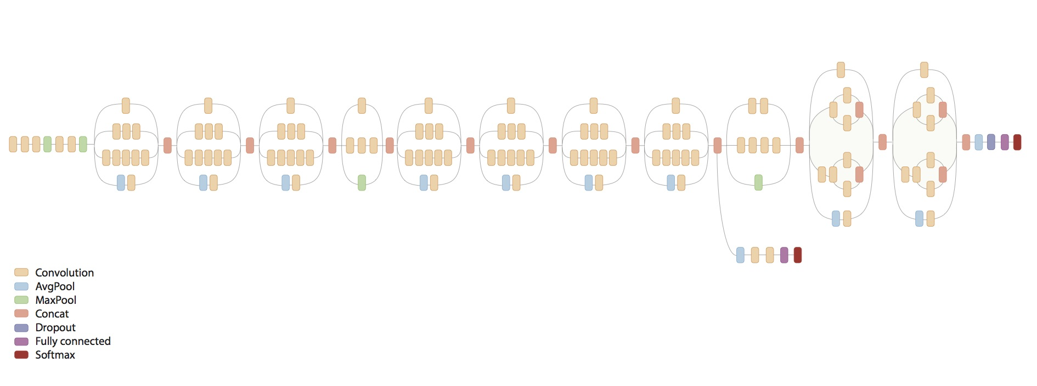
CNN – State-of-the-art
Inception Net or GoogLeNet, >150 layers

Slide 14
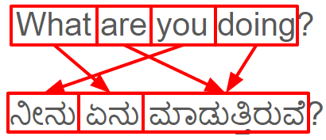
Recurrent Neural Nets
Data is temporal/sequential.
Notes:
Add animation

Slide 15
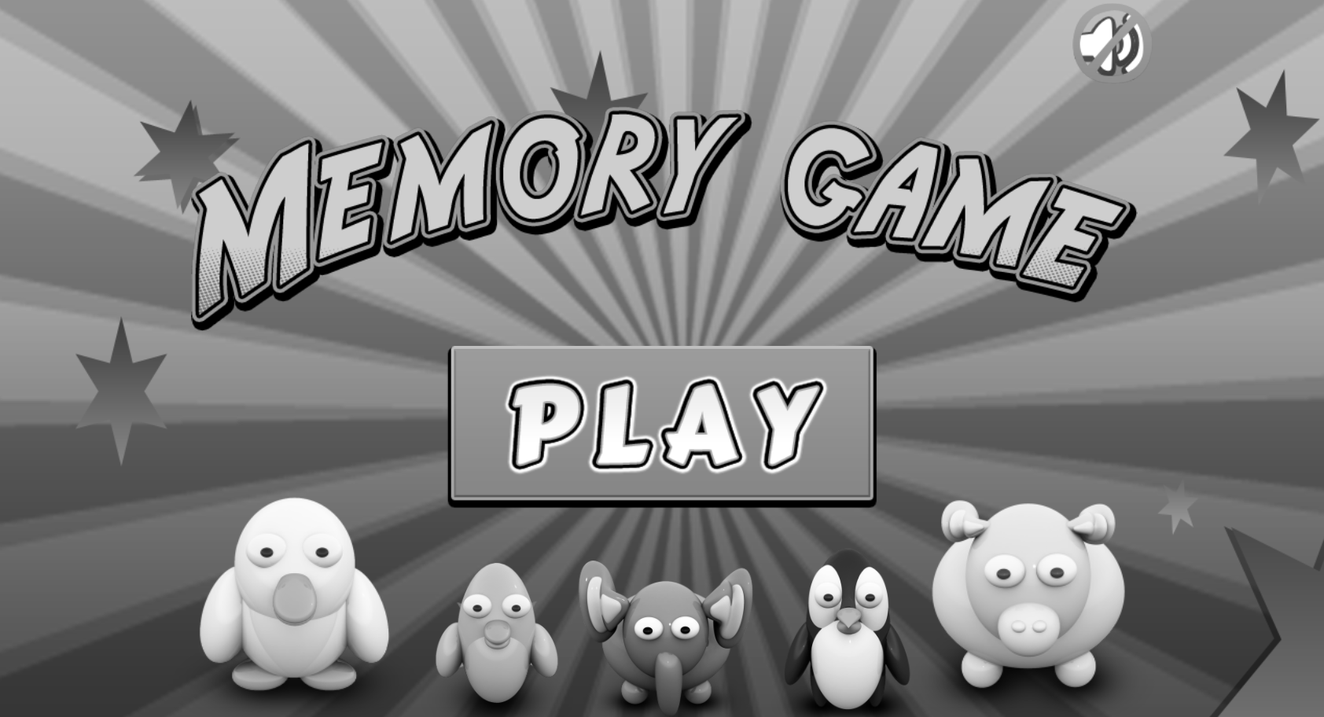
Feed forward vs RNN

Slide 16
Architecture
An RNN contains a
“recurrent” connection
Time: 0
Time: 1
Time: 2

Slide 17

RNN Variants:
Can receive sequence of inputs and sequence of outputs:
Image Captioning

Slide 18
RNN Variants:
Can receive sequence of inputs and sequence of outputs:
Document Classification

Slide 19
RNN Variants:
Can receive sequence of inputs and sequence of outputs:
Video Classification

Slide 20
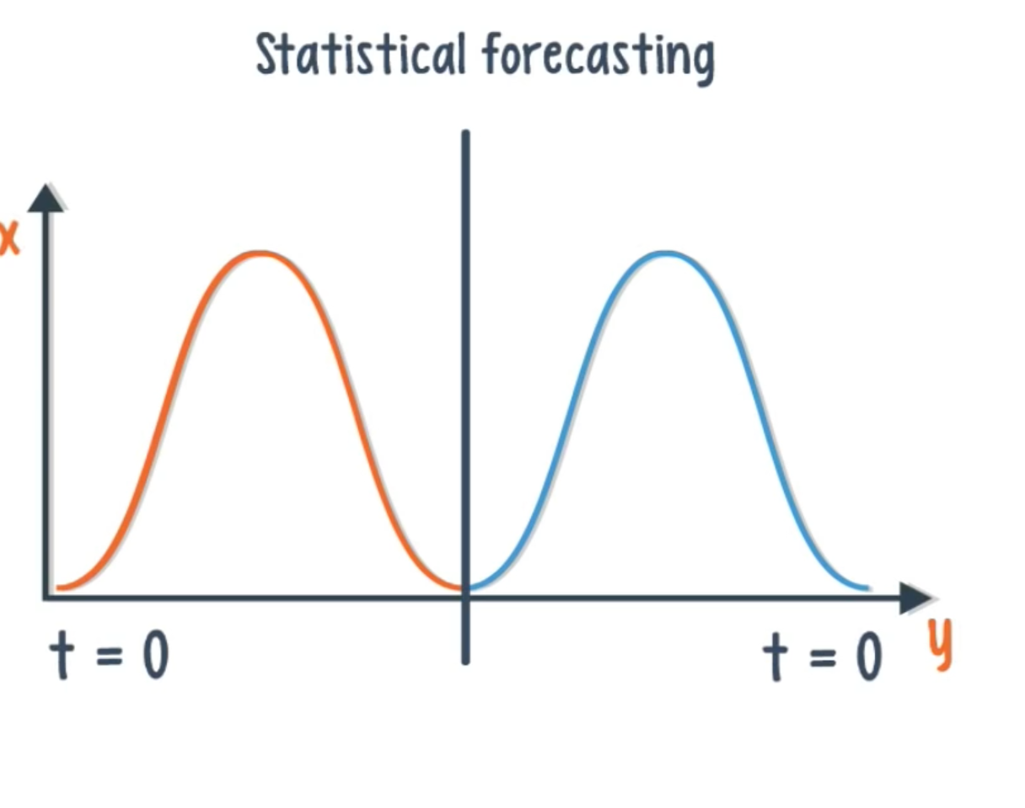
RNN Variants:
Can receive sequence of inputs and sequence of outputs:

Slide 21
Recurrent Neural Nets
They are trained using a variation of Backpropagation Through Time (BPTT)
Problem of vanishing gradient
The reason for this is that each time step is the equivalent of an entire layer in a feedforward network.
So training an RNN for 100 time steps is like training a 100-layer feedforward net – this leads to exponentially small gradients and a decay of information through time.
Solution: GATING

Slide 22
Gating
Gating is a technique that helps the net decide when to forget the current input, and when to remember it for future time steps.
The most popular gating types are :
GRU and LSTM
LSTMs are extremely popular in NLP today
Besides gating, there are also a few other techniques like gradient clipping, steeper gates, and better optimizers.

Slide 23
LSTM
This memory can be seen as a gated cell.
Gated cell decides whether or not to store or delete information
The assigning of importance happens through weights.
Three gates:
Input gate
determine whether or not to let new input in
Forget gate
delete the information because it isn’t important
Output gate
impact the output at the current time step (output gate).

Slide 24
RNN – Encoder Decoder Model
Language A
Question
Sentence
Compound word
Paragraph
...
Language B
Answer
Paraphrase
Constituent words
Summary
...
Encoder
Decoder
Sequence-to-Sequence models

Slide 25
ENCODER DECODER MODEL
Encoder
Input: A variable-length sequence
Output: A fixed-length vector representation
Decoder
Input: A given fixed-length vector representation
Output: A variable-length sequence

Slide 26
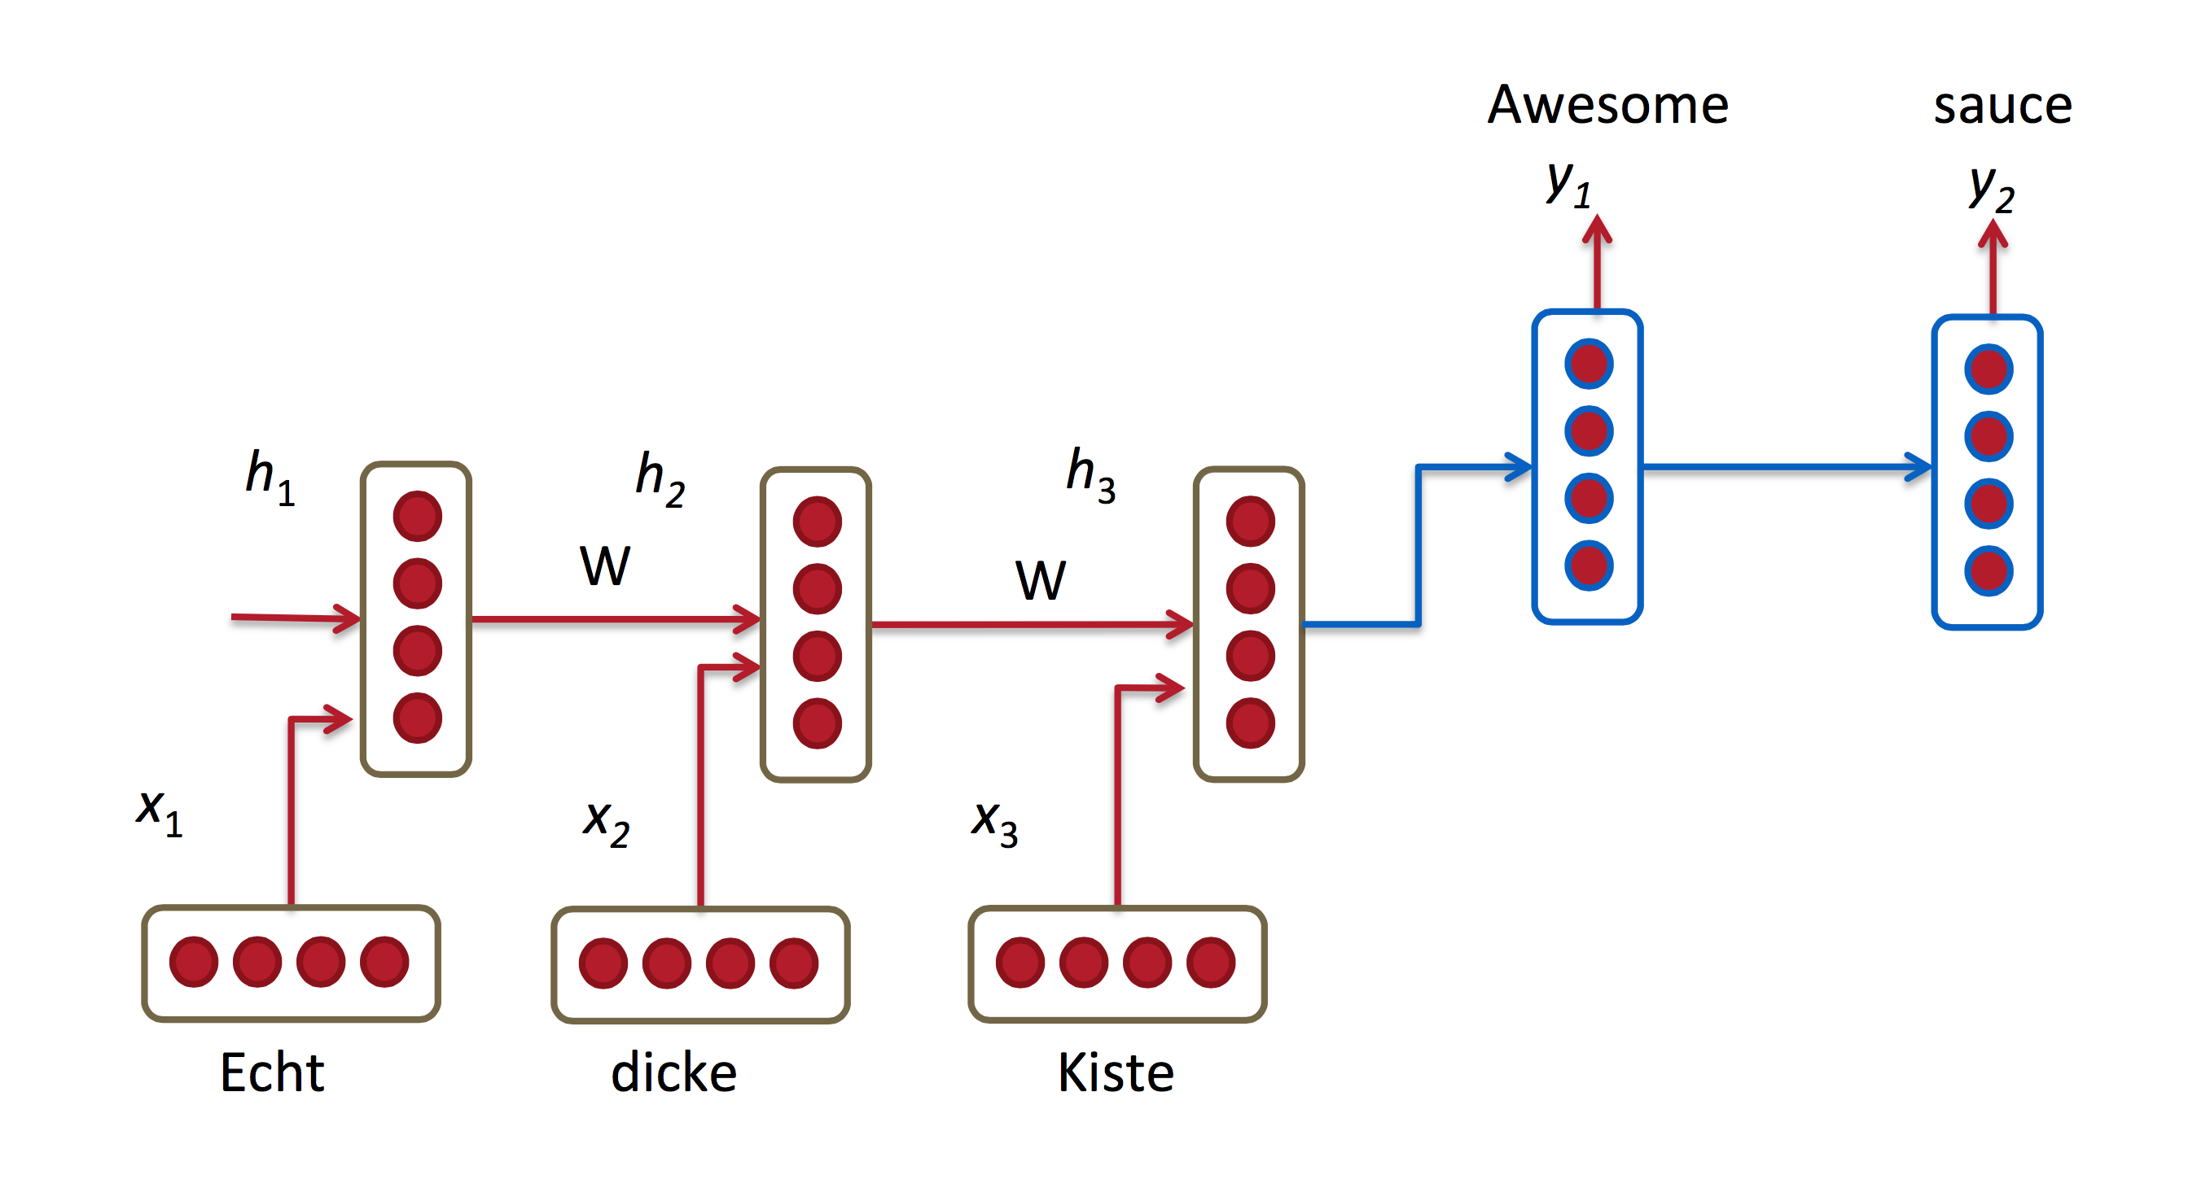
Encoder Decoder Model - Example
Captures entire phrase

Slide 27
Generative Adversarial Networks
Analogy:
Shop owner has to be able to distinguish between the fake and authentic wines.

Slide 28
Generative Adversarial Networks
The goal of the forger is to create wines that are indistinguishable from the authentic ones, and the goal of the shop owner is to accurately tell if a wine is real or not.

Slide 29
Generative Adversarial Networks

Slide 30
Generative Adversarial Networks
Generative Network:
Producing images that are closer to real images.
Discriminative Network:
Determine difference between real and fake images.
Aim: Generative network that can produce images which are indistinguishable from the real ones.
Use cases:
Generating realistic artwork samples (video/image/audio)
Image to Image Translation
Image super resolution
Image Inpainting
Text to Image

